Slide 1
DIGITAL MUSIC STORE ANALYSIS
SQL PROJECT
BY
AVINASH

Slide 2

Objective
This project will teach how to analyze the music
playlist data base
Provide insights and recommendations to optimize the performance and competitiveness of digital music stores.
Determine opportunities for growth and improvement within the digital music store market.

Slide 3
INSIGHT
Got Information About Senior Employee
Best Customer Based On Invoices
The Best City Based On Invoices
Artist Who Wrote Who Wrote More Rock Music
Most Popular Music Genre Of Each Country
Average Song Length Of The Dataset
Customer Spent Amount For The Songs

Slide 4
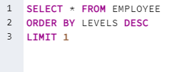

Who is the senior most employee based on job title
2. Which country have the most Invoices

Slide 5


What are top 3 values of total invoices
4. Which city has the best customer ? based on sum of invoices

Slide 6
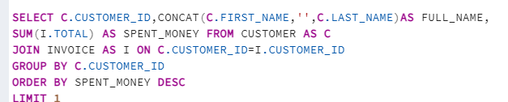
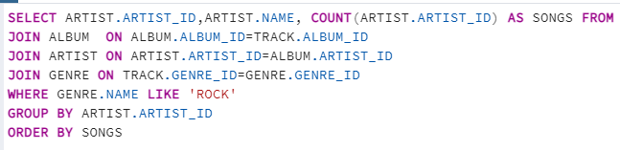
Who is the best customer? The customer who has spent the most
money will be declared the best customer
Lets invite the artist who have written the most rock music
Write a query that returns the artist name and total track count

Slide 7

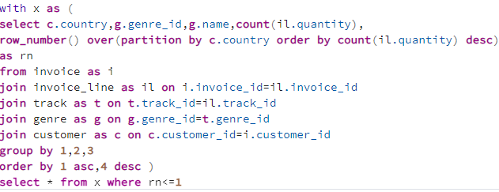
Return all the track names that have a song length longer than the average song length
8 .We want to find out the most popular music genre of each country

Slide 8
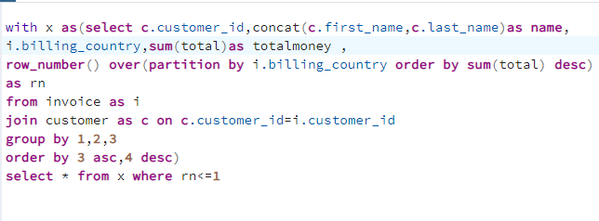
9. Write a query that determine the customer that has spent most on
Music for each country
Write query that returns the country along with the top customer and
How much they spent

